Slide 1


CARBON CURING IN PRECAST STRUCTURES
Faculty Mentor: Dr.P.Vasanthi
Team Members: Mohamed Jackiria Fazith, Arularasan.S.E
Department of Civil Engineering
Chennai Institute of Technology
Kundrathur, Chennai 600069
1

Slide 2
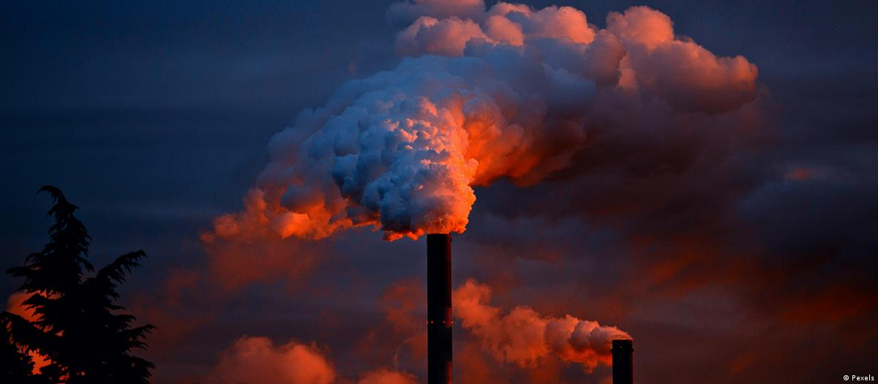
.
.
.
INTRODUCTION
Context Setting: Our project centers on the innovative carbon curing process, revolutionizing Conventional concrete production methods by mitigating CO2 emissions.
Identified Challenge: Conventional concrete production contributes significantly to greenhouse gas emissions through industrial flue gases, exacerbating climate change and environmental degradation.
Proposed Solution: By implementing carbon curing techniques, we capture and utilize CO2 emissions in concrete production, transforming them into a valuable resource while enhancing the strength and durability of concrete structures.
Expected Impact: Anticipating a substantial reduction in CO2 emissions, carbon-cured concrete not only offers enhanced performance but also fosters environmental sustainability by effectively sequestering carbon dioxide,
2

Slide 3
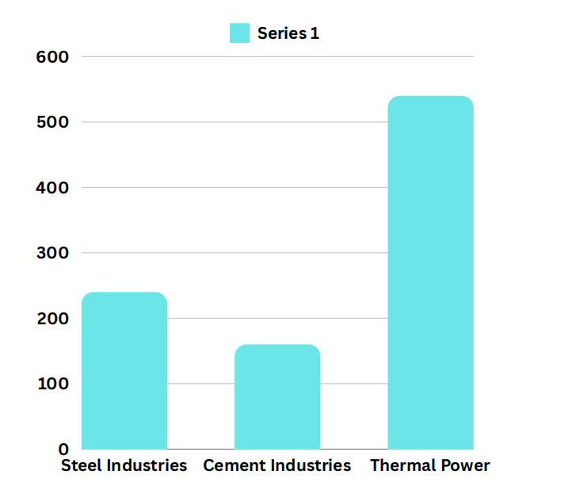
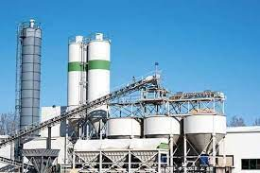
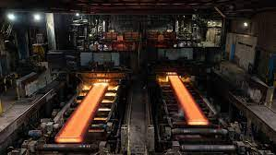
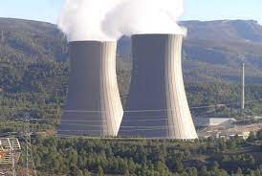
Scenario of Carbon Dioxide Emission from Different Industries
SOURCE | CO₂ Emission (million-tonnes) | Composition (%) | Remarks
POWER SECTOR | 983 | O₂ - 3-5 CO₂ - 12-14 N₂ - 72-77 | more than 40% of all energy-related carbon dioxide emissions
STEEL SECTOR | 164 | CO₂ - 20-25 CO - 20-25 H₂ - 5 | 5.63% of the country's total emissions
CEMENT SECTOR | 297 | CO₂ - 60-70 NO_{X} - 10-15 SO₂ - 1-5 | The steel industry in India contributes to around 12% of the country's carbon dioxide emissions.
Carbon Emission in Tonnes per Year
3

Slide 4

Problem Statement
Carbon Emission: Current methods for curing of concrete structures doesn’t meet with the current environmental sustainable conditions.
Underutilization of Emissions: Without proper utilization methods, these emissions go unused, representing a missed opportunity for sustainable resource management and environmental mitigation
Urgent Need for Innovation: The International Energy Agency (IEA) reports that a staggering 33.5 billion tonnes of CO2 are emitted annually, intensifying the urgency for
the construction industry to address this issue through
further research..
4

Slide 5
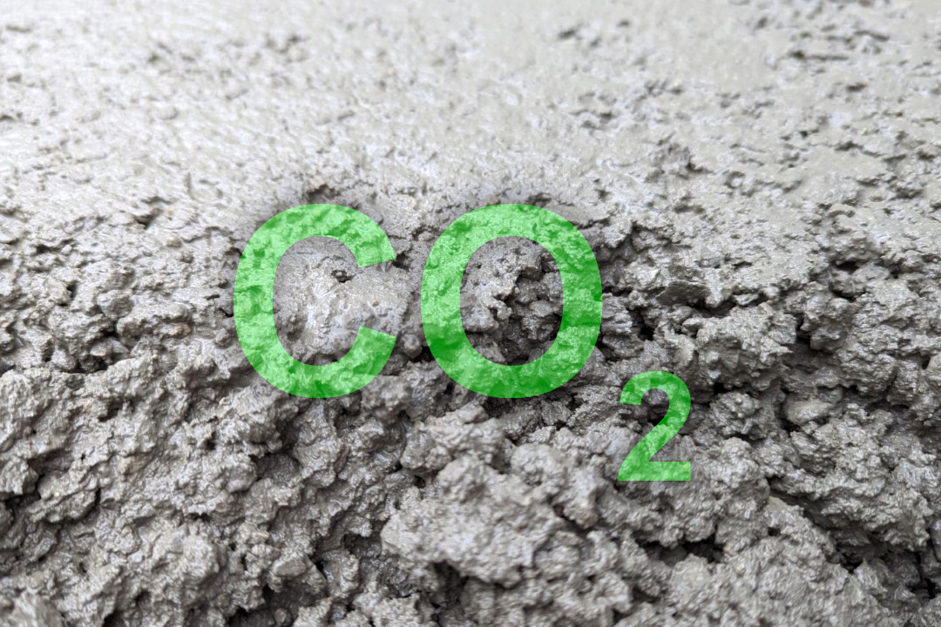
OBJECTIVES
To develop an appropriate technology for capturing of carbon dioxide from industrial flue gases
To implement the captured carbon dioxide for curing of concrete in construction industries
To evaluate the performance of carbon dioxide curing in terms of environmental pollution control and sustainability
5

Slide 6
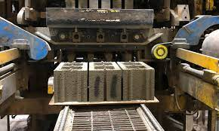
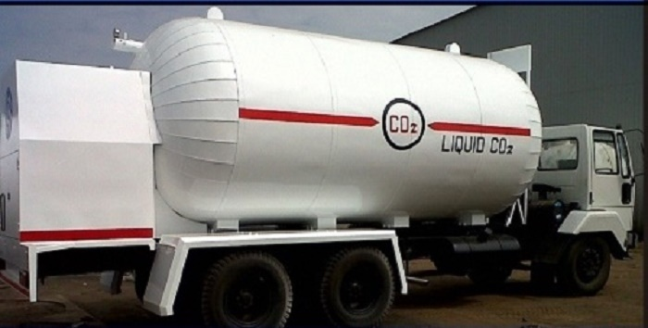
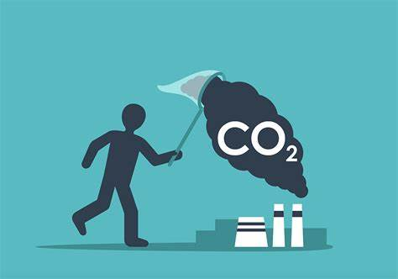
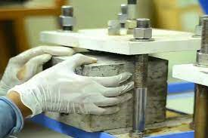
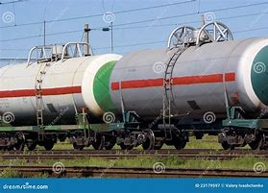
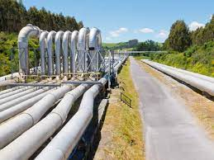

OUTLINE OF THE PROJECT
Flue Gas from Industries
1.Pre-Combustion
Curing Process
By Truck
2.Post -Combustion
Experiment and Performance Evaluation
Transportation
CO₂ Capturing
3.Oxy-Combustion
By Pipelines
Environmental sustainability
6

Slide 7
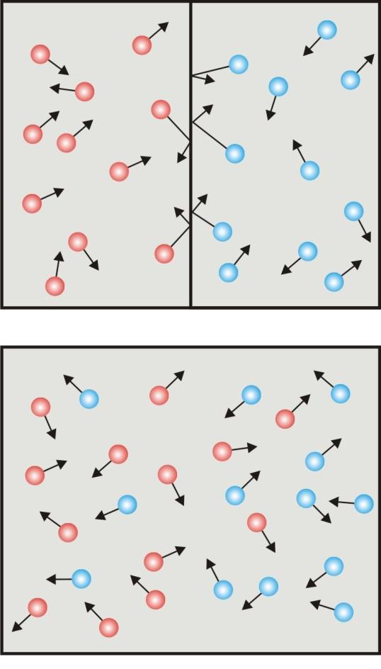



Method Used for Carbon Extraction from Feed gas
Post-Combustion Capturing
CO2(g) + MEA(aq)
MEA - CO2(aq)
MEA - Monoethanolamine
Heat Dissipation
Flue Gas Without CO₂
Solvent Regeneration
Fuel
95-97% pure CO₂ and Compressed
Solvent-Co₂ solution
Solvent
BOILER
Fuel is burnt with air
ABSORBER TOWER
Solvent separate C$O_{2}$
from other gasses
STIRPPER TOWER
Heat is used to separate the C$O_{2}$ from the solvent
Solvent
7

Slide 8
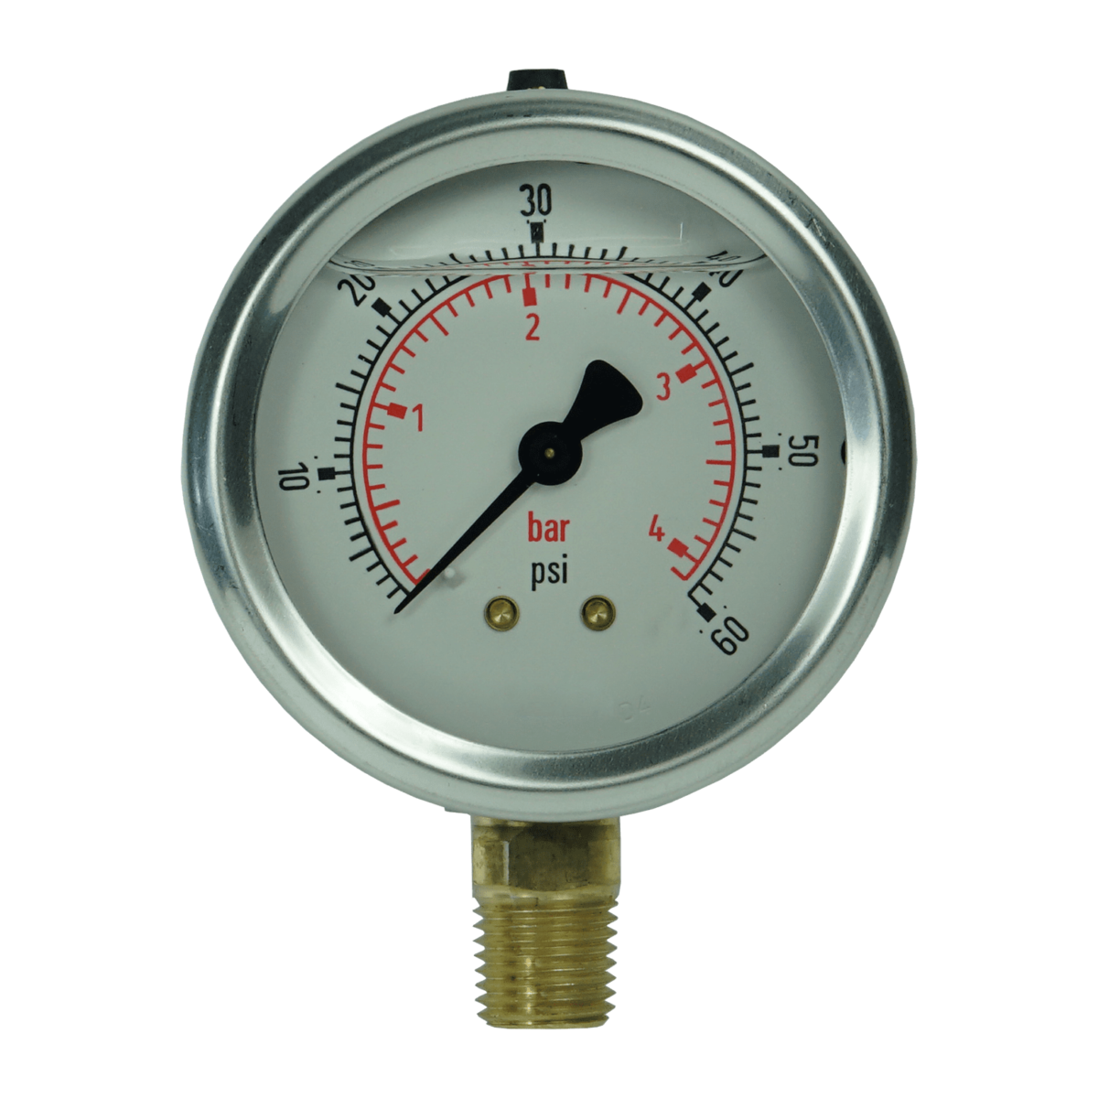
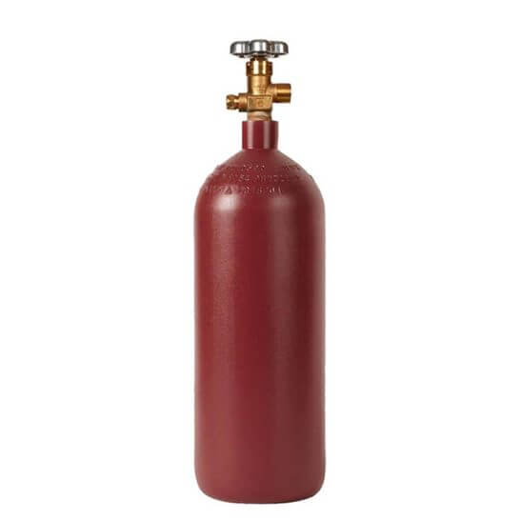
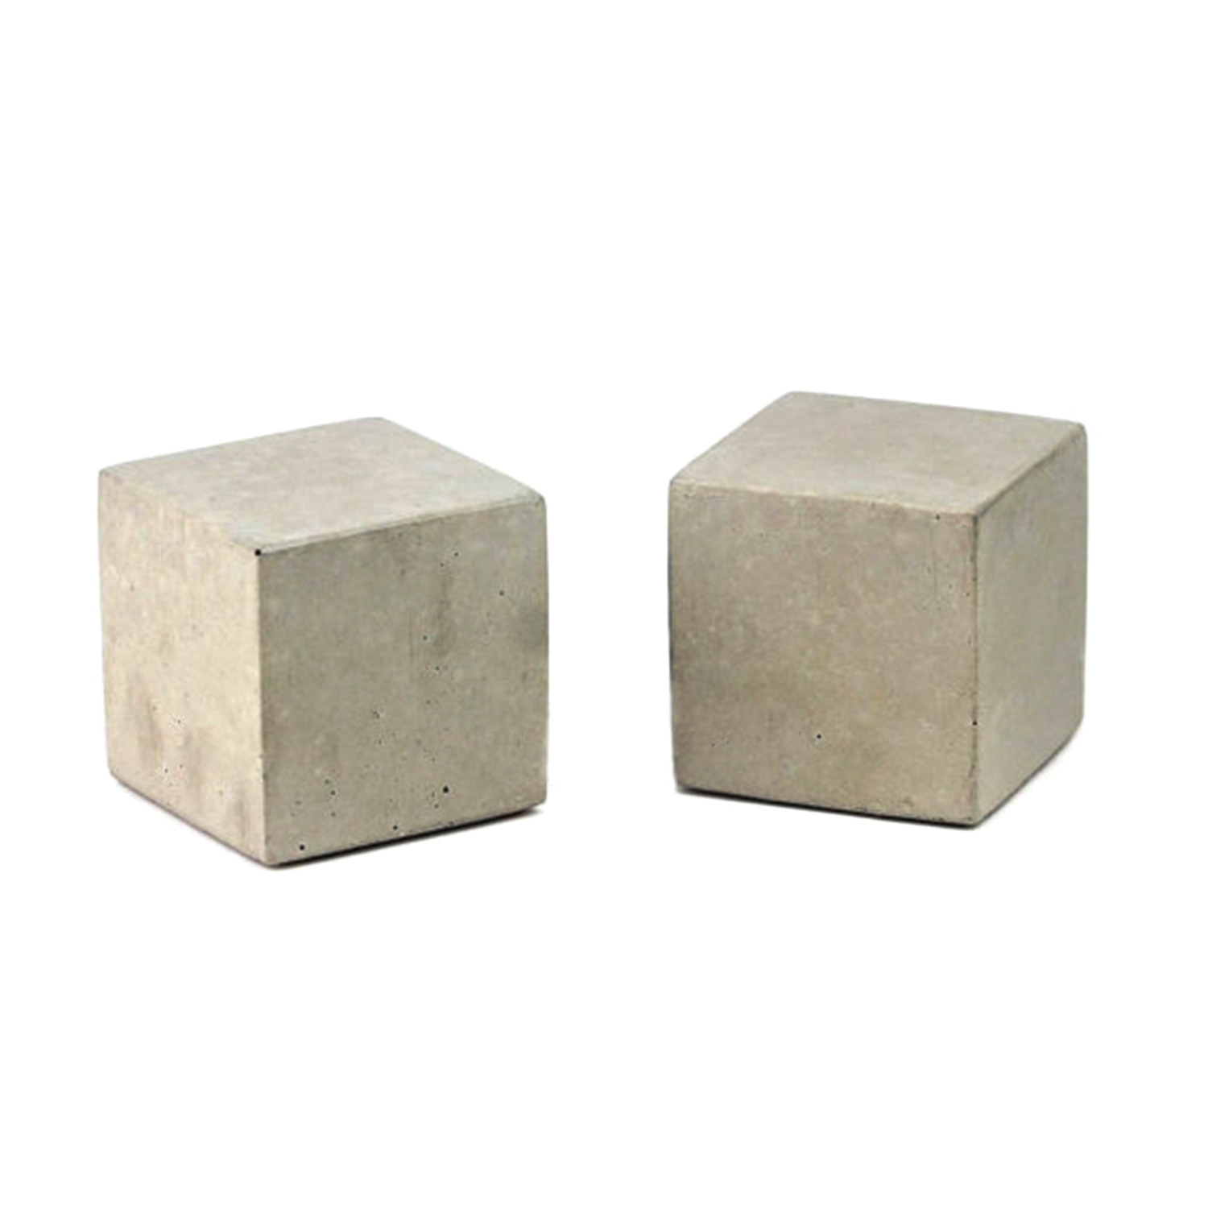

Curing and Ca$rbonation Process$
Pressure Gauge
Switch Valve
Pressure Gauge
3CaO.SiO₂+3CO₂+XH₂O
SiO₂.XH₂O+3CaCO₃
Switch Valve
2CaO.SiO₂+2CO₂+XH₂O
SiO₂.XH₂O+2CaCO₃
Gas Inlet
CO₂ Gas Flow
Gas Outlet
CO₂
Temperature Control System
Online Temperature Monitoring system
Curing Chamber
8

Slide 9
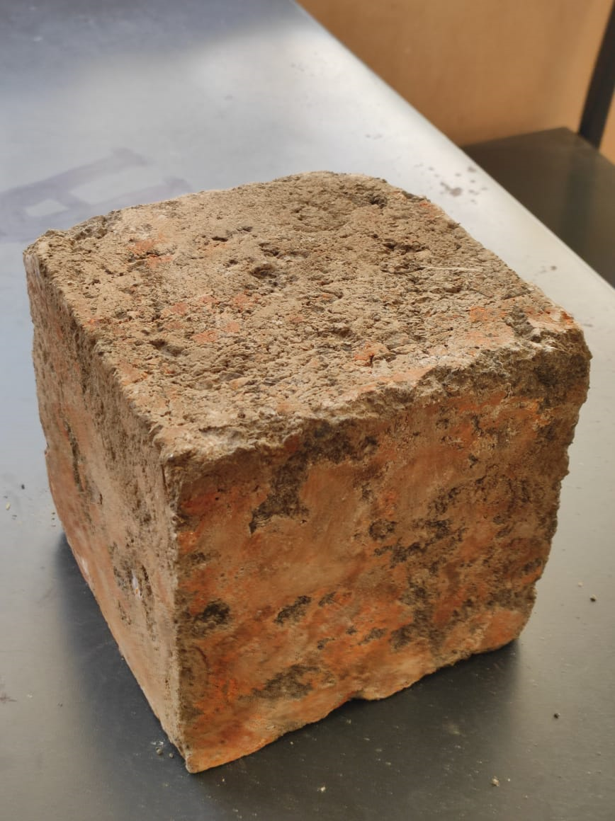
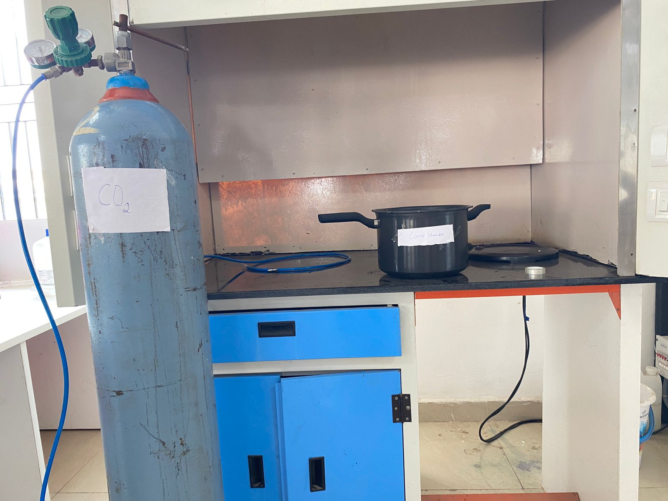
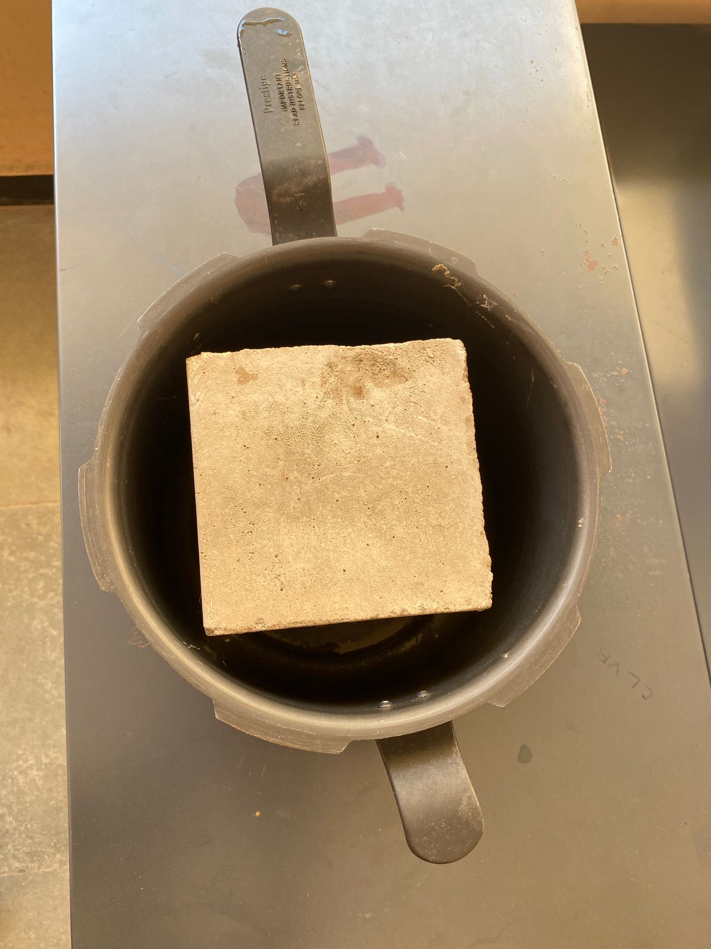
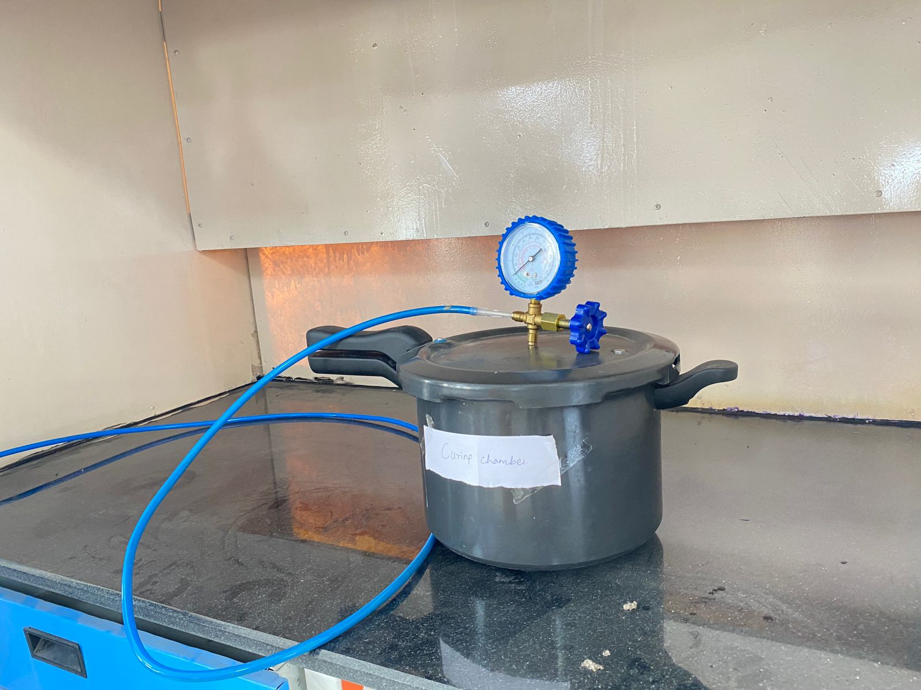
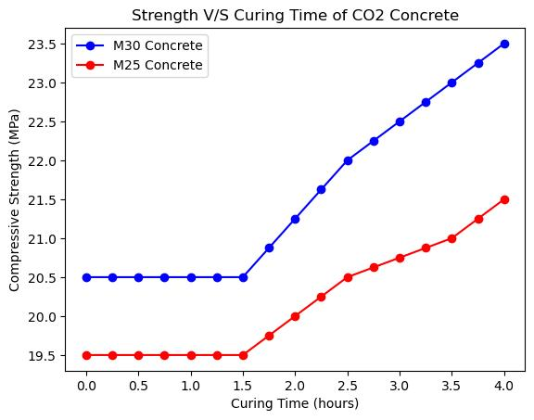
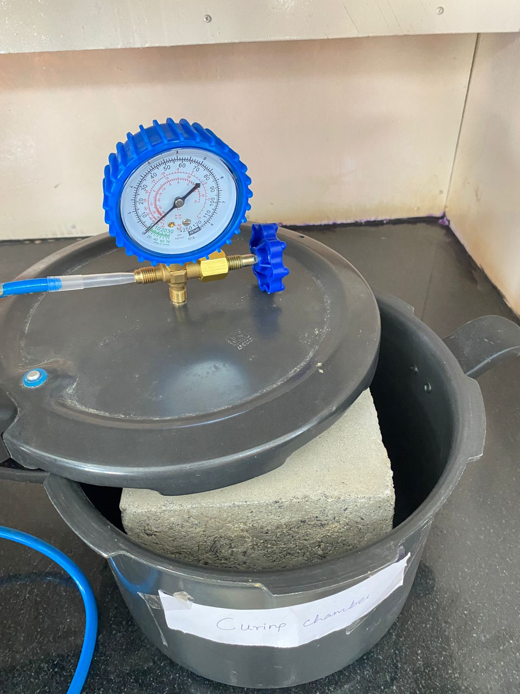
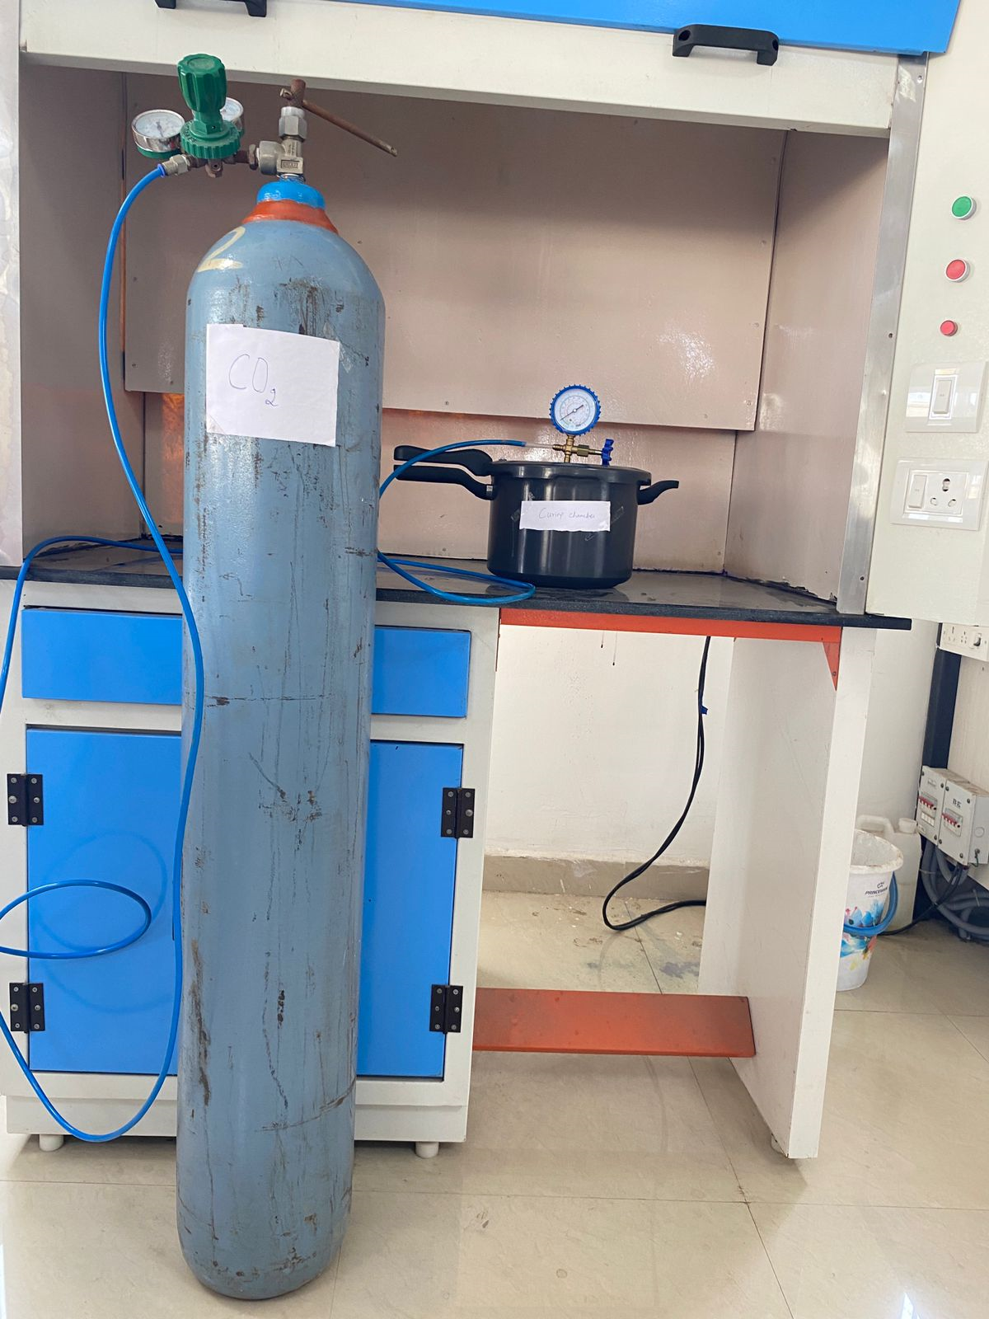
Preliminary Works Done-on Curing Concrete using Carbon Dioxide
Cube Specimen
Cooker as Curing Chamber
Specimen with Curing Chamber
Curing Chamber with Pressure Gauge
Performance Analysis
After Curing
Process of Carbon Curing
9

Slide 10
DELIVERABLES
Reduces Carbon Footprint - 70% to 90%.
Reduced curing period – 7 days
Energy consumption in curing
Achievement of earlier compressive strength
Environmental sustainability
10

Slide 11
CONCLUSIONS
Carbon Curing Method in the construction industry presented.
Post Combustion Carbon Capturing Method was adopted in this work for curing of concrete.
This approach is energy-efficient, reduces the carbon footprint
It aligns with global sustainability goals and represents a shift towards eco-friendly practices. Hence, the Concrete retains the Carbon permanently with the support of a strong bonding between lime and Carbon.
Therefore Compounded Results help to witness Sustainable growth in the Environment
11

Slide 12

THANK YOU
“We are the first generation to feel the impact of climate change and the last generation that can do something about it.”— Barack Obama

